Slide 1







JDK & GIT & Environment Setup
Andrei Mladin

Slide 2
Java Development Kit
(JDK -> JRE -> JVM)

Slide 3
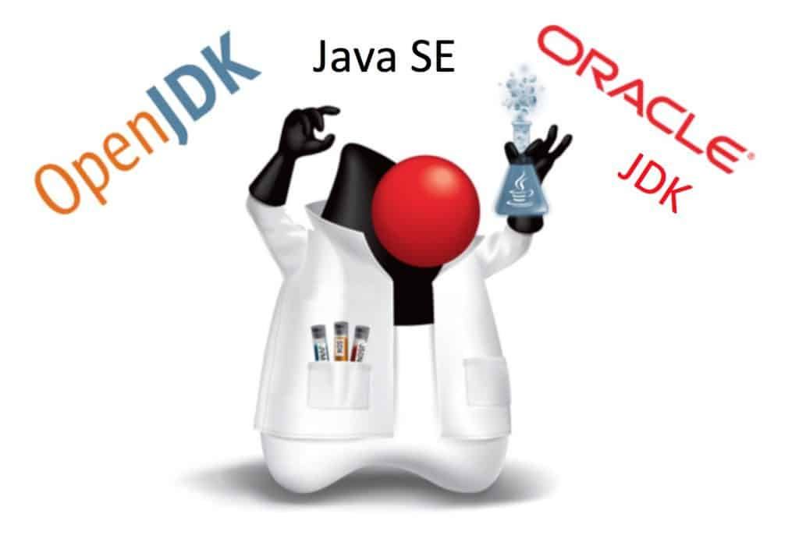
JDK implements JSE
Type to enter a caption.

Slide 4
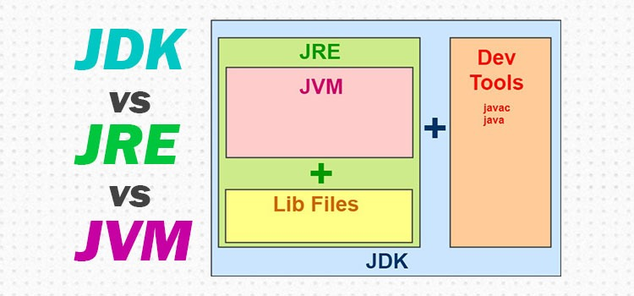
JDK includes JRE & JVM
Type to enter a caption.

Slide 5
JDK: Write A Simple Java Program
public class ITeaHome {
public static void main(String[] args) {
System.out.println("Welcome to ITea Home Academy!");
}
}

Slide 6
JDK: Compile A Simple Java Program
javac ITeaHome.java

Slide 7
JDK: Run A Simple Java Program
java ITeaHome.class
output: “Welcome to ITea Home Academy”

Slide 8
Version Control
Tracking

Slide 9

Version Control: Old Way
Type to enter a caption.

Slide 10

Version Control: New Way
Type to enter a caption.

Slide 11
GIT
Most popular

Slide 12
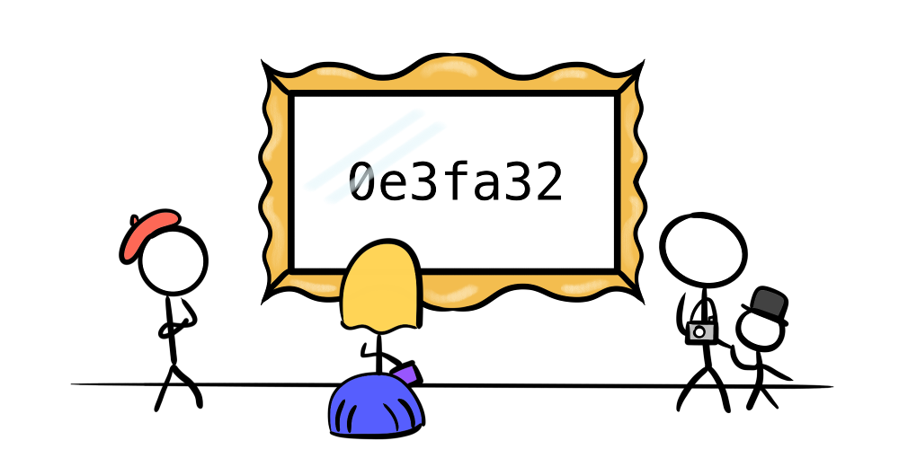
GIT: Hash Commit
Type to enter a caption.

Slide 13
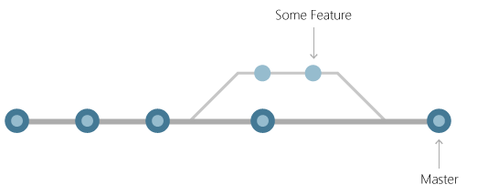
GIT: Branch
Type to enter a caption.

Slide 14
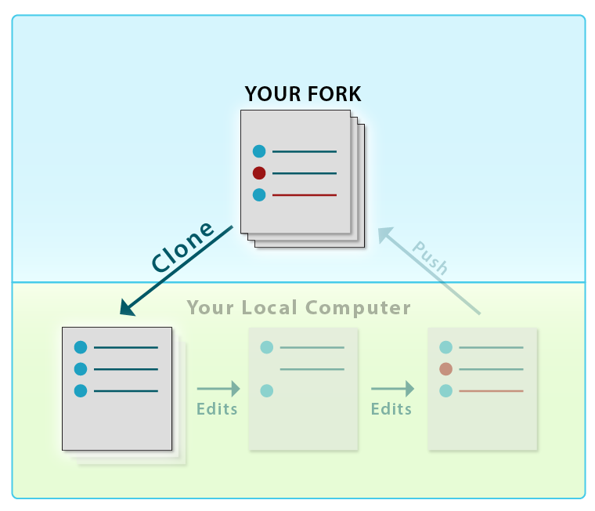
GIT: Clone
Type to enter a caption.

Slide 15
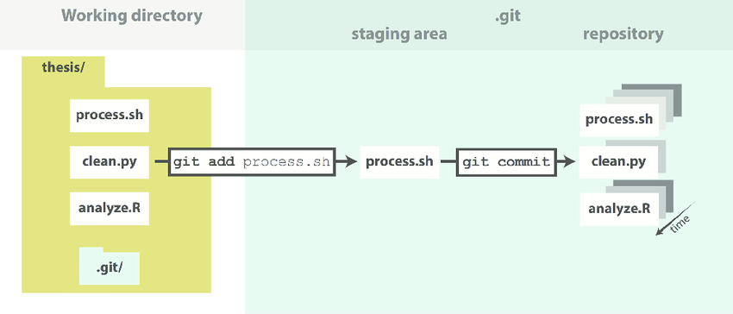
GIT: Areas
Type to enter a caption.

Slide 16
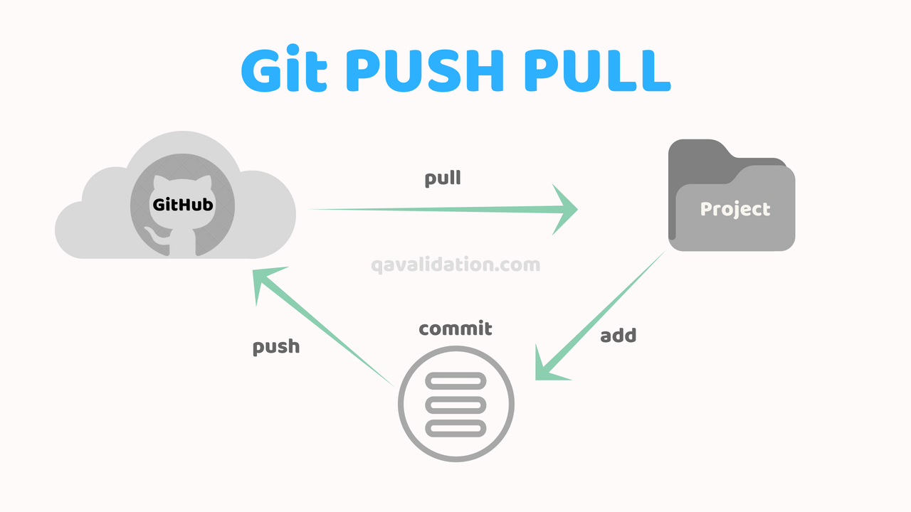
GIT: Push/Pull
Type to enter a caption.

Slide 17
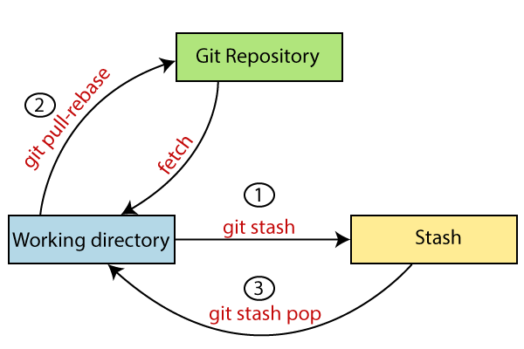
GIT: Stash
Type to enter a caption.

Slide 18
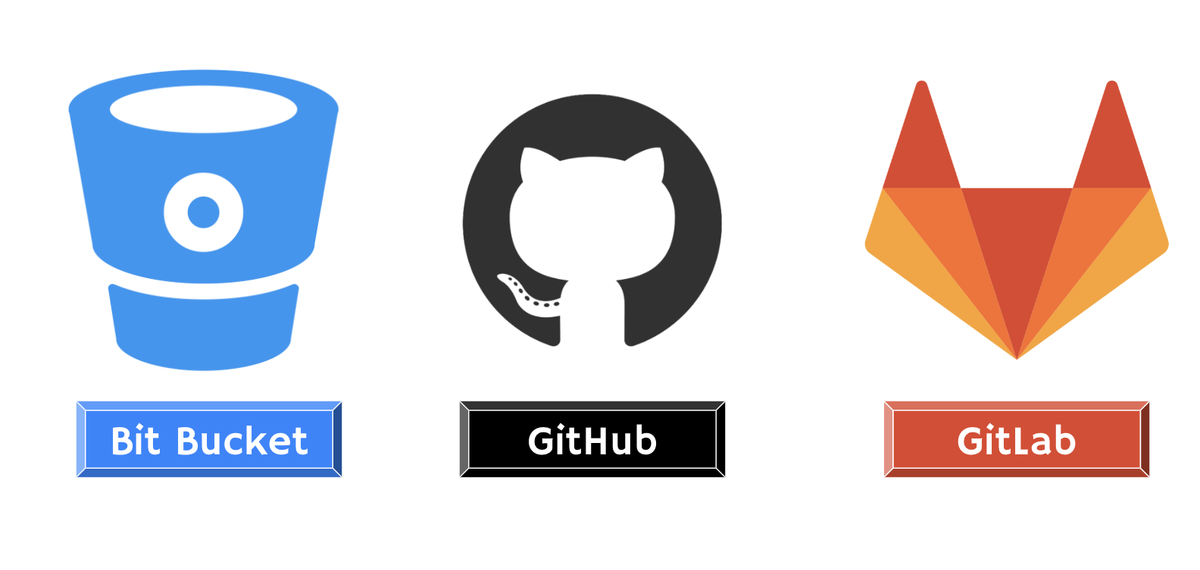
GIT: Online Platforms
Type to enter a caption.

Slide 19
IDE
More than Notepad

Slide 20

IDE: Most popular ones
Type to enter a caption.

Slide 21
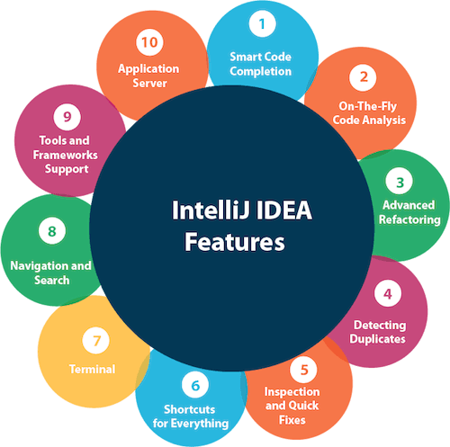
IDE: Most popular ones
Type to enter a caption.

Slide 22
Thanks
See you next Tuesday

Slide 23
Bibliography
https://www.javaworld.com/article/3296360/what-is-the-jdk-introduction-to-the-java-development-kit.html
https://git-scm.com/book/en/v2
https://www.jetbrains.com/help/idea/set-up-a-git-repository.html
https://www.youtube.com/watch?v=lyiBnyPPnG4
https://www.jetbrains.com/idea/

